Slide 1
Digital
Logic circuits, microprocessor communication, serial and parallel, I²C, SPI, PWM

Slide 2
How do we communicate in mechatronics?
Analog communications can be voltage level or current level. A 4-20 ma current loop is a common analog communications system used in industry. To read an analog voltage we use an analog to digital converter.
Converting between analog and digital is really important in sending data. We must also consider the concept of sampling.
Pulses can convey information by their amplitude and/or their duration. (In what ways is like digital, in what ways is it no?)
Pulses can also encode binary information and form data packets
Really high clock speeds have enabled easy digital implementation with high data content.

Slide 3
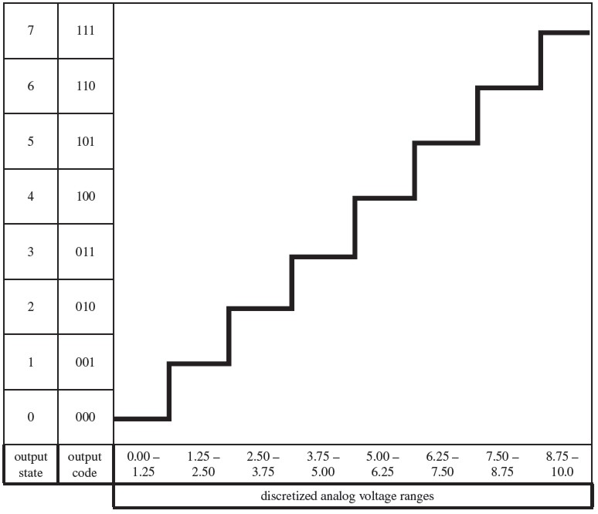
A to D
Now that we have decided how fast to sample, we must Quantize and Code.
This is the next question. Bit depth & sample rate give the amount of data and the data transfer rate needed.

Slide 4
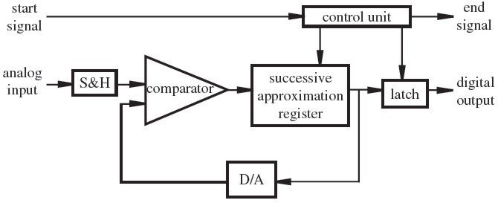
A to D: 2 ways
Successive Approximation – Modify most significant bit, compare, and decide. Modify next bit, compare and decide, modify next bit, compare and decide, … modify LSB compare and decide. Used in Arduinos
takes nΔT to decide on a value, 1 to 100 μs
What if input value changes?
Flash Converter – Fast. Parallel comparator (AKA Direct Conversion). But requires 2^{n}-1 comparators for n-bit precision. Impractical for more than 8-bit
See next example
Notes:
Use track and hold circuit

Slide 5
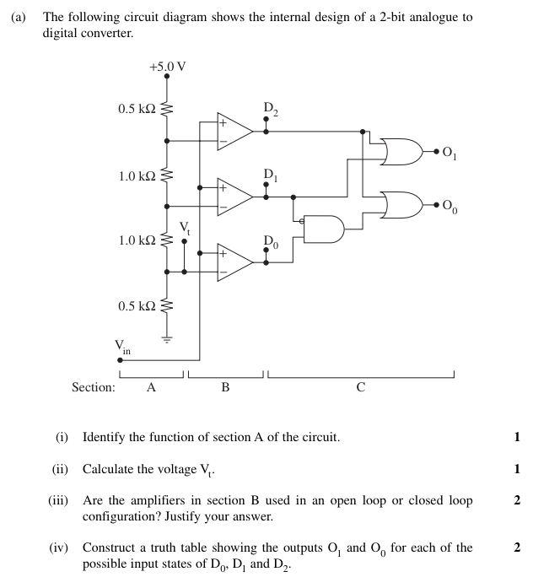

Slide 6
A to D when the signal changes with time
If you want to create a digital record of a time-varying signal you must ask the question:
“How frequently do I need to record the value of the signal?”
This question was answered by founders of information theory and is commonly called the Nyquist–Shannon sampling theorem
It says that for any signal with a period of T is perfectly recorded when sampled at least 2 times every period. (a sample rate of 2/T). This is called the Nyquist rate
You will see later on in the unit that any signal can be represented as a linear sum of sin and cosine waves of different frequencies
Sampling below the Nyquist rate may result in aliasing. That is what is causing the strange effects seen in the video.
If you are interested in more than just “What is the value of the signal now?”, then you also need to consider the sampling rate
Notes:
We often take this step for granted. But it should be the first question asked in designing a system. ECG example.

Slide 7
Pulses that convey more than just binary information ~ PWM and Pseudo Analog

Slide 8
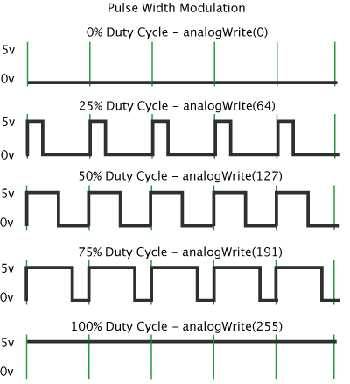
“analogWrite” uses Pulse Width Modulation (PWM)
Gets analogue results with digital means.
Easy to control and implement using high clock rates by switching on and off precisely.
Can define the period as you like.
Can be used for controlling power to a DC motor
Used to control LED intensity

Slide 9
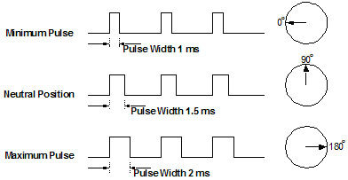
The servo library uses a slightly different version of Pulse Width Modulation (PWM)
PWM is a convenient way to send analog-like signals
The servo.h library creates a special type of PWM pulse.
The duration of the pulse tells the servo arm where to go.
#include <Servo.h>, myservo.write(val); where 0 ≥ val ≤ 180
The pulse-on time normally varies from just 1 to 2 ms. So the duty cycle is always low.
The low duty cycle allows 3 or 4 different control signals to be carried on the same waveform, and multiplexed to a common frequency for multichannel RC control.
In this scenario the first pulse might be throttle, the second might be steering, or for airplanes, it might be lifters, rudder or ailerons.

Slide 10
Binary pulses for digital information
Digital devices or structures are categorized as combinational or sequential logic.
In sequential logic, the timing or sequencing history of pulses is used to determine the ouput.
in combinational logic, the output is defined by the instantaneous value of the inputs.
In this unit, you need to be comfortable with the binary number system

Slide 11
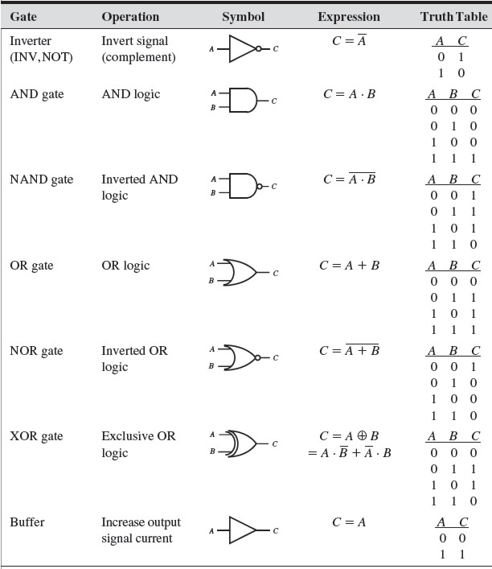
Digital Circuits can be based on Combinational logic
Combinational logic converts binary to binary on mathematical logic rules. They are called gates.
They do not have memory, ie the outputs is a function of what is and not what was.
A note about digital communications
Bit: 1 or 0
Byte: 1 number, or letter. Typically 8 bits, but could be 32 or 64 bit on CPUs
ASCII: 7 bit code for alphanumerics. Usually stored in an 8-bit byte.
Notes:
SMS: short message service are typically either 160-7 bit characters, 140-8 bit characters (Twitter) or 70-16 bit characters for 1120 bits in total

Slide 12
Combinatorial Logic
Combinatorial logic circuits made from discrete semiconductor gates can be used instead of microcontrollers to achieve similar goals. Logic circuits may be cheaper and lower power.
Micro controllers can achieve similar aims though software-based logic structures. In this unit you should understand how to use AND, OR and NOT in the Arduino SDK.

Slide 13
Sequential Logic
The timing or sequencing of input signals determines the output. This requires some form of memory.
Devices include flip-flops, counters, monostables, latches and even microprocessors.
Sequential logic circuits usually respond to inputs only when a separate trigger signal transitions from one level to another. The trigger signal is usually referred to as the clock (CK)
We will examine one important example of a sequential logic device the D or digital Flip-Flop

Slide 14
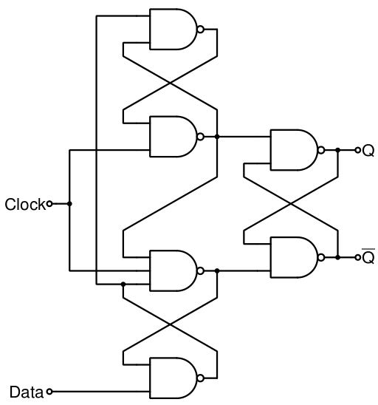
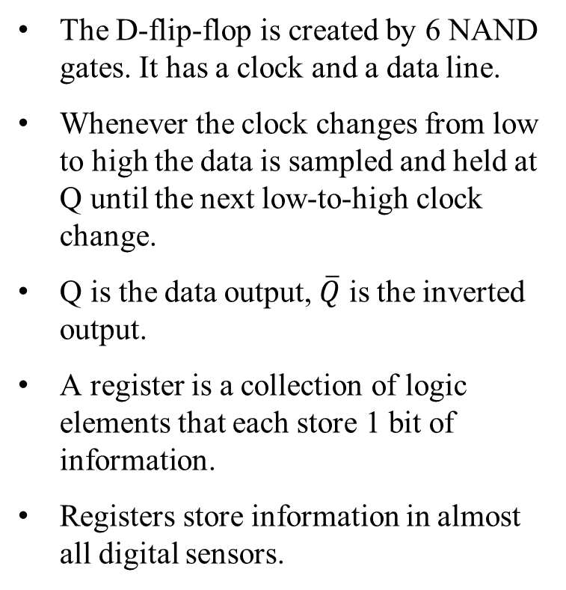
Registers: 1 byte of short memory D Flip Flops
The D-flip-flop is created by 6 NAND gates. It has a clock and a data line.
Whenever the clock changes from low to high the data is sampled and held at Q until the next low-to-high clock change.
Q is the data output, $\overline{Q}$ is the inverted output.
A register is a collection of logic elements that each store 1 bit of information.
Registers store information in almost all digital sensors.

Slide 15
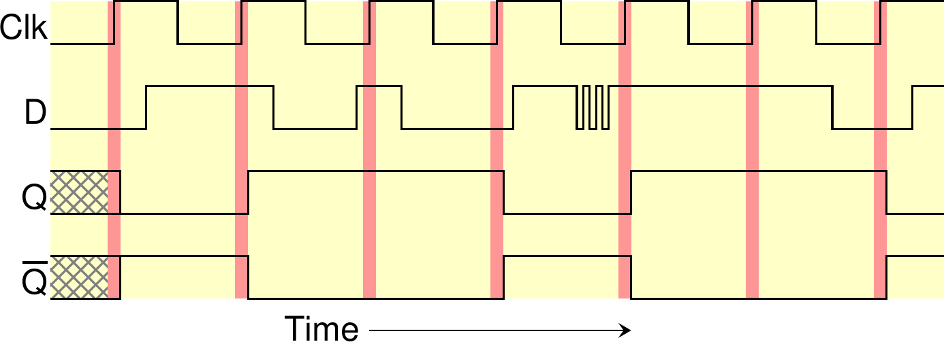
D Flip Flops
Notice that the D signal is sampled only at the rising clock edge. Changes at other times are ignored.
The device remembers the state of D until the next rising edge on the clock line.

Slide 16
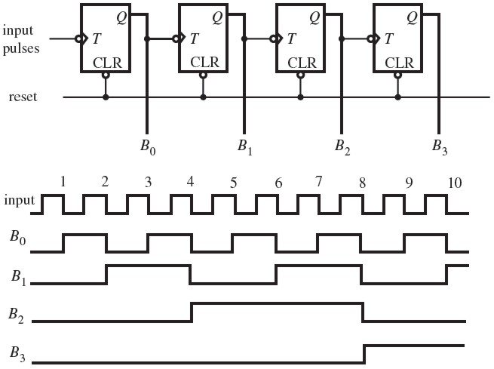
Binary Counter and/or Frequency Divider
Asynchronous Negative edge triggered flip flops
Notes:
Application of flip flops
Note the input changes quickly and the output changes slowly

Slide 17
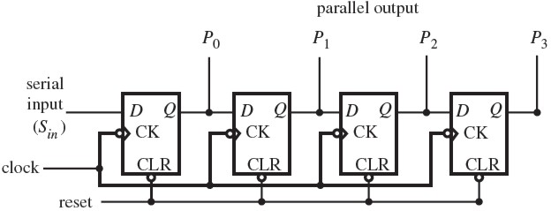
Shift Register or Serial to Parallel Converter
In digital circuits, a shift register is a cascade of flip flops, sharing the same clock,
the output of each flip-flop is connected to the 'data' input of the next flip-flop in the chain
D-Flip Flop
The most common Latch. It has memory!
Used in I2C.
Notes:
You can connect multiple discrete shift registers together to extend this process

Slide 18
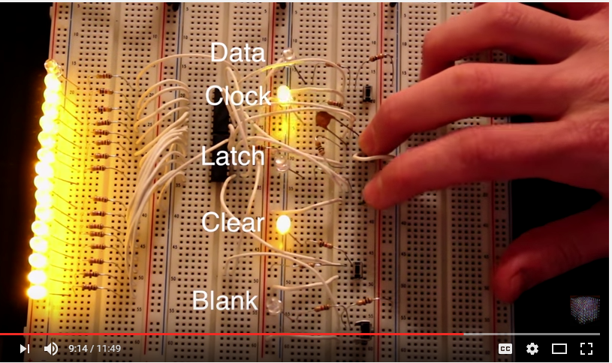
Shift Registers at work
https://www.youtube.com/watch?v=6fVbJbNPrEU
From 2 minutes

Slide 19
Notes:
They key is to be able to tell the 1-bit memory element when to update or sample its input.

Slide 20
I²C
I squared C, inter-integrated circuit is a bus protocol for communication between a mother board and low speed peripherals.
Video

Slide 21
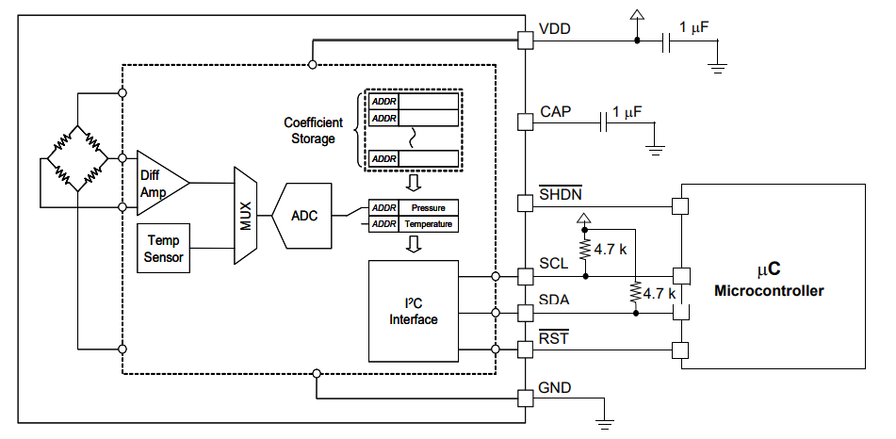
I2C Sensor. How does it works?
Pressure: Air pressure deflects a thin membrane. Strain gauge changes resistance. Wheatstone bridge measures voltage change
Coefficient storage: on-board storage of calibration coefficients. Set at factory.
Difference amplifier converts uV to mV.
ADC converts analog measurement to a serial digital number (8 binaries in a row.)
Serial pressure or temperature data are shifted into a storage register
MUX: multiplexer, switches which signal is sent to the ADC.
When uController asks and listens for the data in a particular register, data is serially read out on the SDA line.
Temperature is probably measured by a BJT whose gain is temperature dependent.

Slide 22
Interrupts
Special pins on any microcontroller
A change of state (HIGH/LOW) triggers a high priority event, that runs immediately: Interrupt Service Routine (ISR)
Use when you absolutely cannot miss an event. Eg. Position control of a robotic arm.
If microcontroller is not paying attention and the position of a relative encoder changes, the system no longer has control of the arm. BAD!
Remember: Keep your ISR very brief. No delay, while, serial communication…
If interrupts are triggered too often, or they take too long, the rest of the program cannot run.

Slide 23
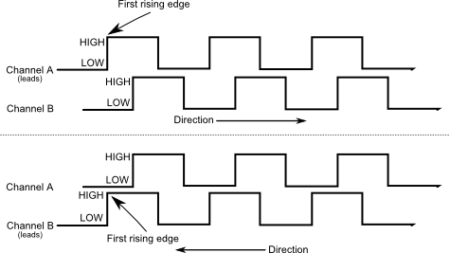
Quadrature Encoder + Interrupt
2 pulse trains that are 90 degrees out of phase allow you to determine direction
This is the key mechanism behind position control using an absolute encoder
Use an interrupt on A or B or A &B to make sure you don’t miss a change in position
Use a counter to keep track of the number of ticks moved.
How many counts per revolution on your encoder? What is the angular precision?

Slide 24
Example Questions
Given a 12-bit A/D converter operating over a voltage range from -5 V to 5 V, how much does the input voltage have to change in order to be detectable?
Modify the 2 bit A to D Flash converter from the notes to linearly encode a 0 to 3.3 V input.
How many pull-up or pull-down resistors are needed to implement 4 different I2C sensors with an Arduino.
What happens when pin 10 of a 74HC595 pin is pulled low?
What happens when pin 13 of a 74HC595 pin is held high?
Give a line or two of code to get an arduino to output a 5V square wave with a duty cycle varying from 0 to 100%. You do not need to use any delays. What is the frequency? What pins does this work on?
Sketch the time-based output of pin 9 using the following code:
void setup() { myservo.attach(9);}
void loop() { myservo.write(20);}

